Slide 1

Neural Network Challenges

Slide 2
Common Challenges in Neural Networks
- Overfitting:
Occurs when the model fits the training data too closely, limiting generalization.
- Vanishing Gradients:
Gradient becomes very small during backpropagation, hindering learning.
- Exploding Gradients:
Gradient becomes excessively large, leading to instability during training.

Slide 3
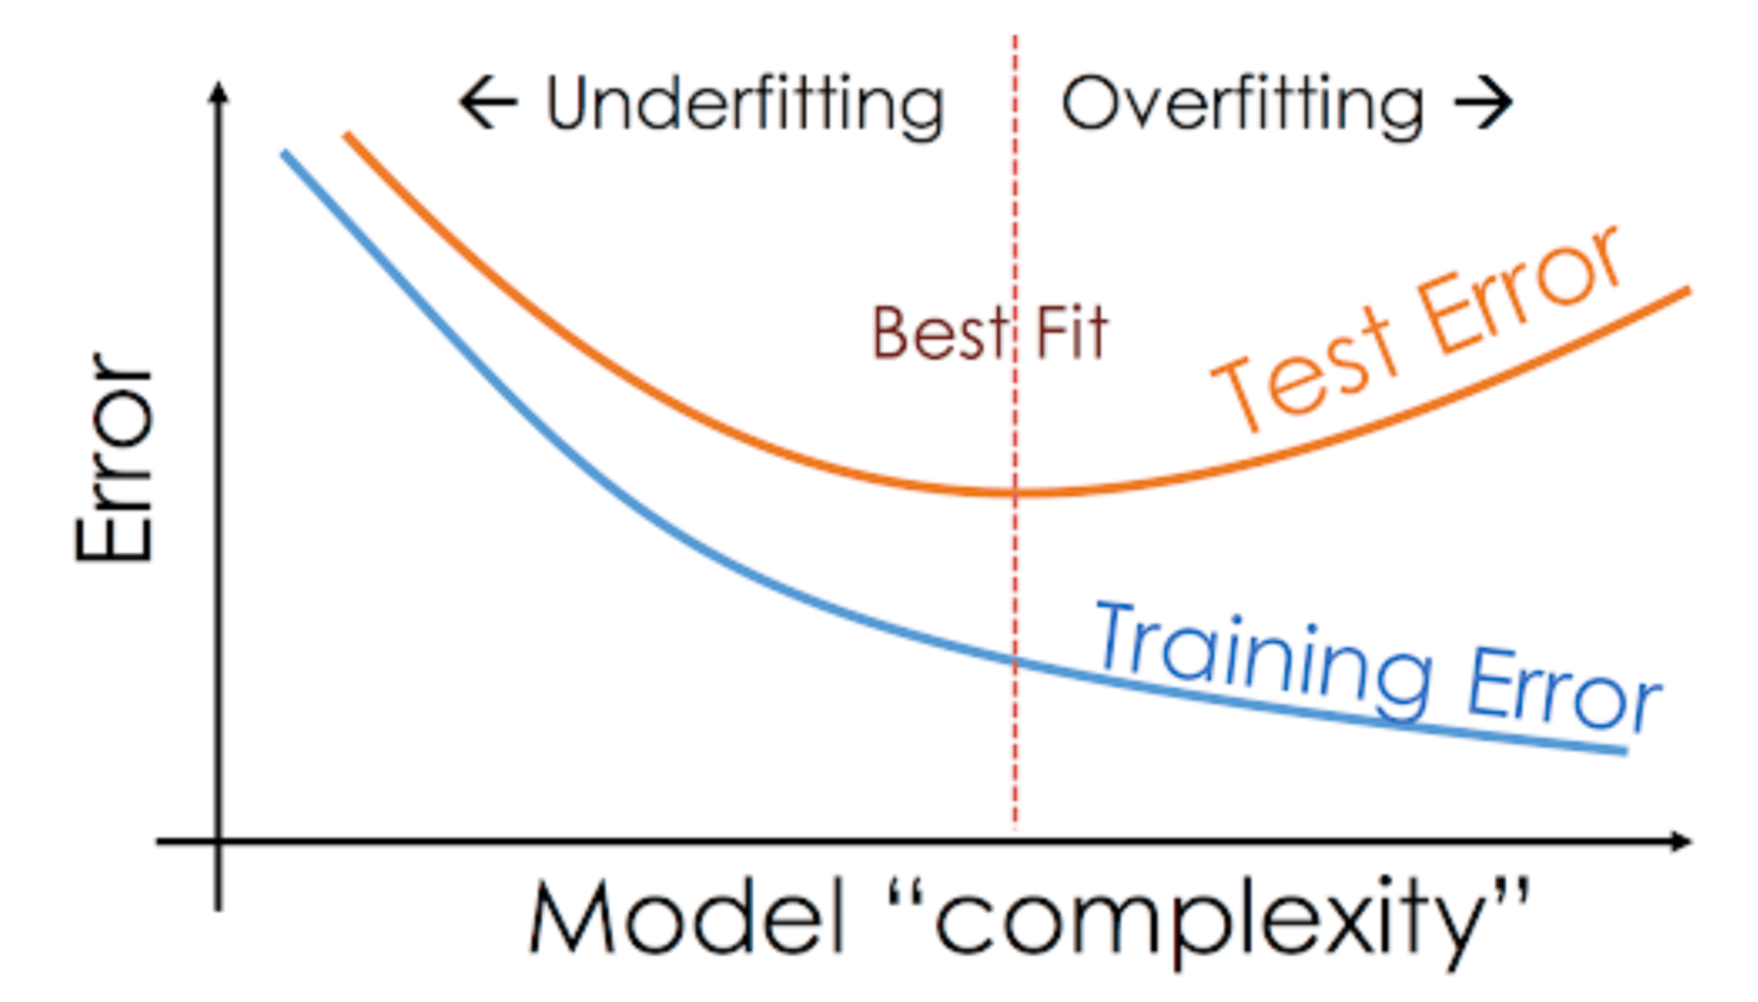
Overfitting vs Underfitting
Overfitting: Overfitting occurs when a machine learning model learns the training data too well, capturing noise and outliers, and as a result, it performs poorly on new, unseen data.
Underfitting: Underfitting happens when a model is too simple to capture the underlying patterns in the data, leading to low accuracy on both the training data and new, unseen data.

Slide 4
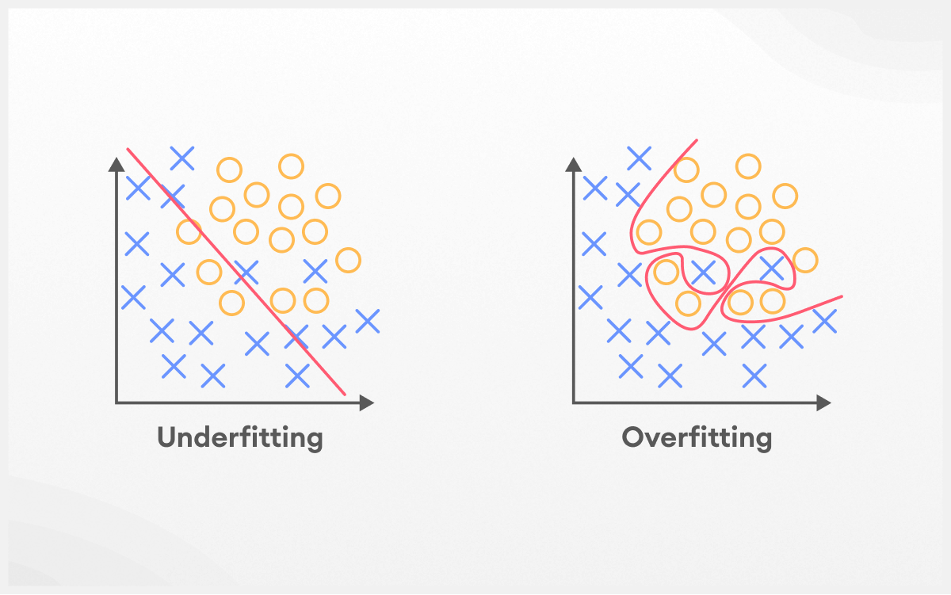
Solution to Overfitting and Underfitting
Overfitting Solution: To address overfitting, reduce model complexity by simplifying the architecture, increasing the size of the training dataset, and applying regularization techniques such as L1/L2 regularization or dropout to prevent the model from becoming too specialized to the training data, use early stopping.
Underfitting Solution: To overcome underfitting, increase model complexity by adding more layers or neurons, enhance feature representation, and collect more relevant data to provide the model with sufficient information to capture underlying patterns in the data

Slide 5
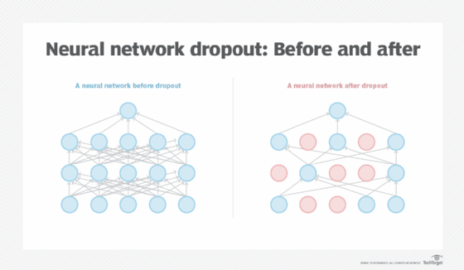
Overfitting Solution: Dropout
Dropout is a regularization technique used in neural networks during training to prevent overfitting. It involves randomly "dropping out" (i.e., setting to zero) a proportion of neurons in each layer during each forward and backward pass.

Slide 6
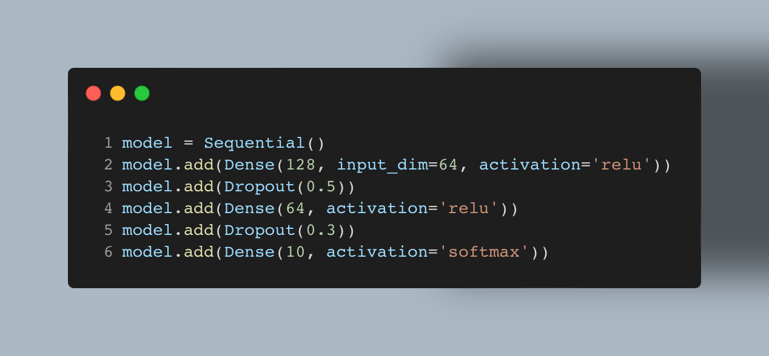
Overfitting Solution: Dropout Code

Slide 7
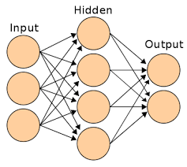
Challenges in ANN
Limited Complexity:
- Struggles with complex tasks due to a shallow architecture.
Feature Engineering:
- Requires manual feature extraction, limiting adaptability.

Slide 8
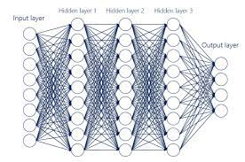
Challenges in DNN
Computational Complexity:
-Intensive training and inference processes, demanding resources.
Overparameterization:
- High number of parameters may lead to overfitting.

Slide 9
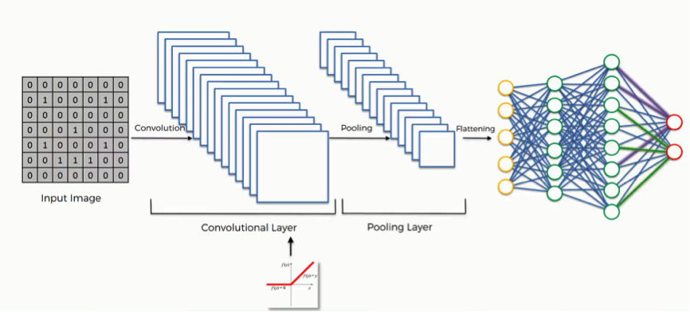
Challenges in CNN
Limited Capturing:
- Convolutional layers may not capture long-range dependencies.
Large Data Requirements:
- Require substantial labeled data for effective training.
Adversarial Attacks:
- Craft perturbations can lead to misclassification.

Slide 10
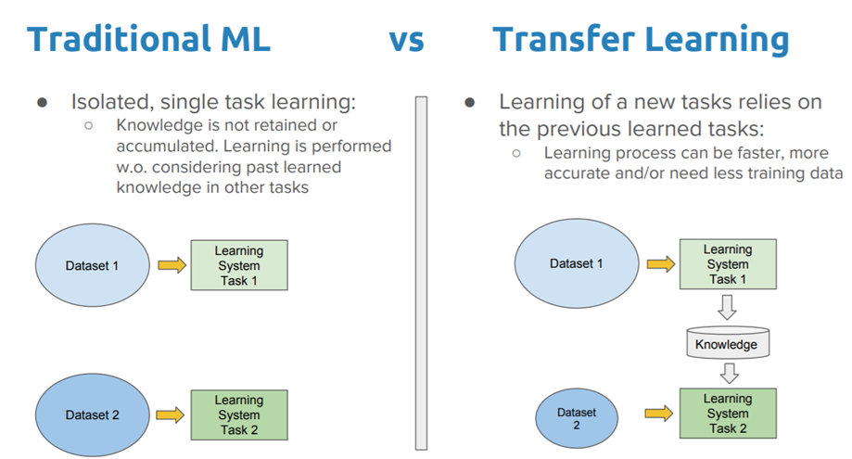
Transfer Learning
Transfer learning is a machine learning technique where a model trained on one task is adapted for a second related task. Instead of training a neural network from scratch, transfer learning leverages knowledge gained from solving a source task to improve performance on a target task. This approach is particularly useful when the target task has limited labeled data.

Slide 11
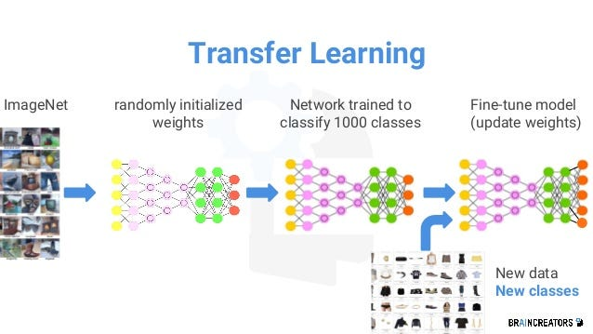
Transfer Learning Steps
- Choose Pre-trained Model:
Select a pre-trained model that was trained on a large, relevant dataset. Popular choices include models trained on ImageNet for computer vision tasks.
- Remove or Modify Output Layer:
Adapt the model for the target task by replacing or modifying the output layer to match the number of classes in the target task.
- Fine-tuning:
Optionally, fine-tune the model on the target task's dataset. This involves updating the weights of some or all layers of the pre-trained model.
- Train on Target Task:
Train the adapted model on the target task's dataset, possibly with a smaller learning rate.

Slide 12
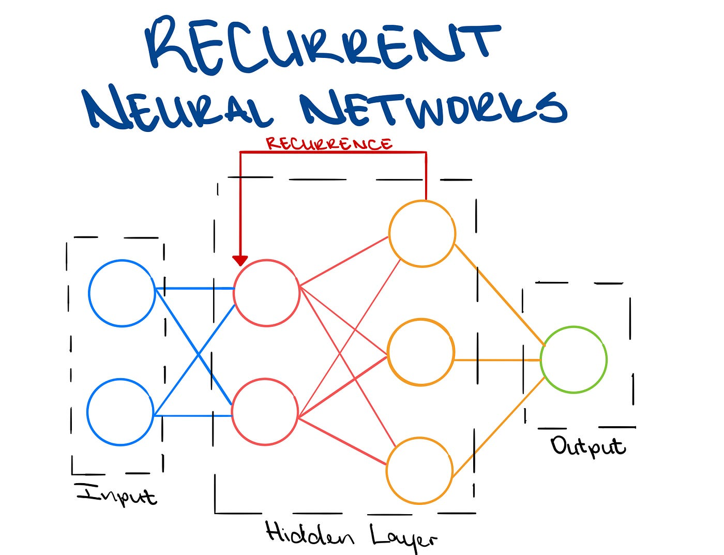
Challenges in RNNs
Vanishing Problem:
- During backpropagation when the gradients become extremely small.
Exploding Gradients:
- When the gradients during backpropagation become extremely large.
Limited Parallelization:
- Slower training due to sequential processing.

Slide 13
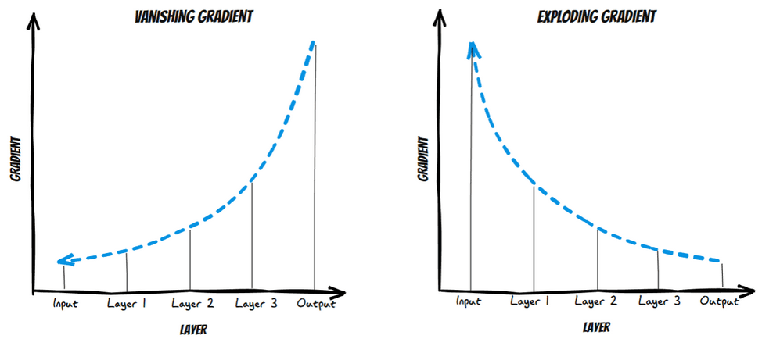
Vanishing vs Exploding Gradients
Vanishing Problem:
- During backpropagation when the gradients become extremely small.
Exploding Gradients:
- When the gradients during backpropagation become extremely large..

Slide 14
Vanishing and Exploding Gradients Solution
Solution to Vanishing Problem:
- Use ReLU or its variants like Leaky ReLU activation function.
- Use a LSTM model or GRU to address this problem.
Weight Initialized Strategies:
- Use techniques like Xavier/Glorot initialization, which helps control the scale of weights.

Slide 15
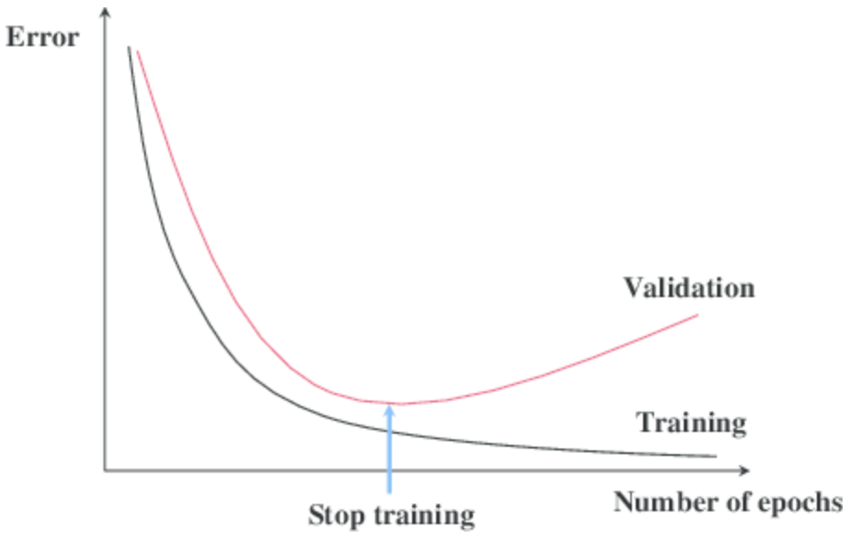
Techniques to use in Neural Network
Common Techniques to use in Neural Networks:
1- Early Stopping.
Implement early stopping to prevent overfitting and save computation time.
2- Hyperparameter Tuning.
Hyperparameters are configuration settings that are external to the model and are typically set before the training process begins.

Slide 16
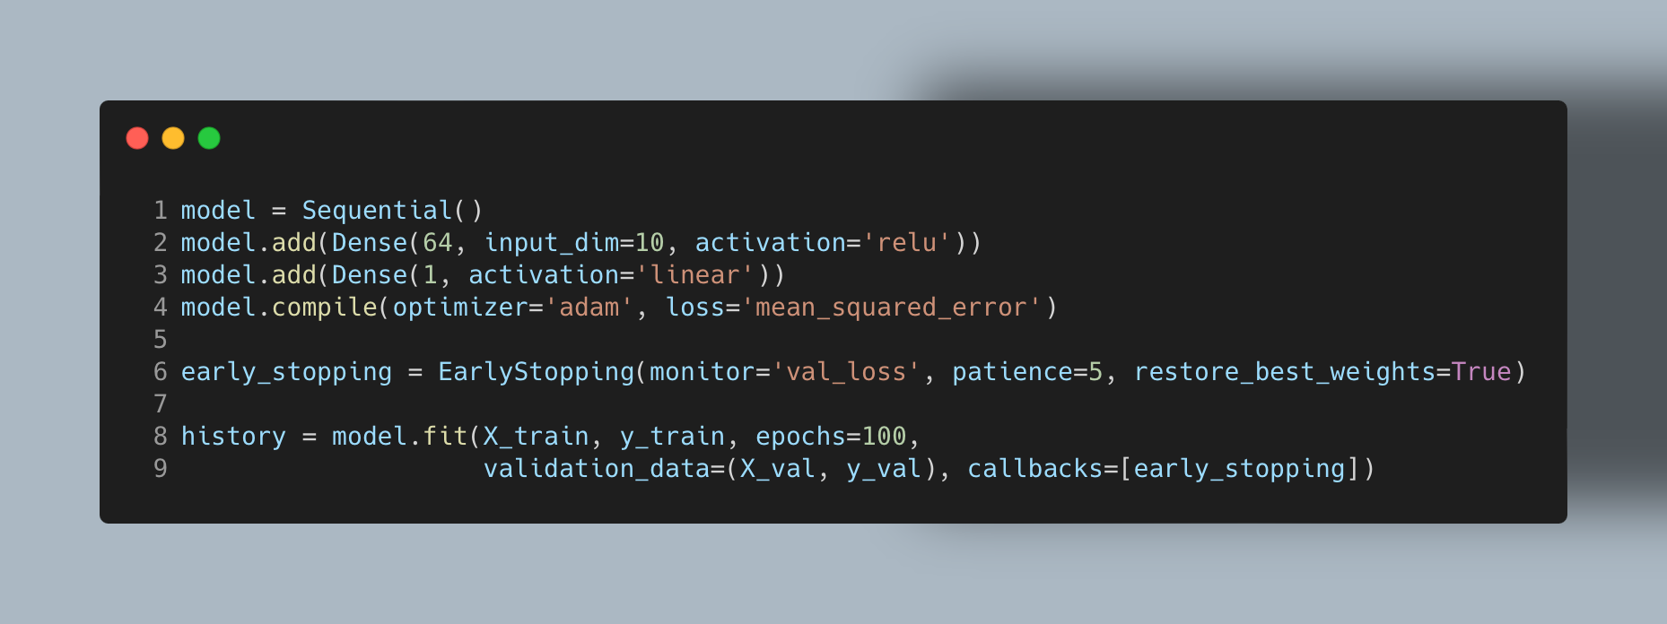
Early Stopping

Slide 17
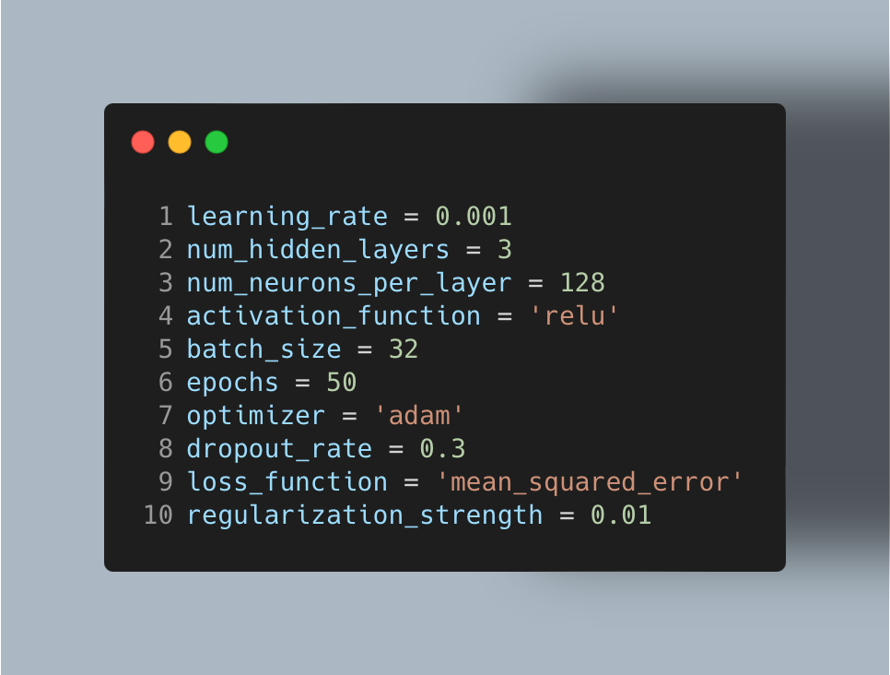
Hyperparameters Tunning

Slide 18
Thank You

